Slide 1
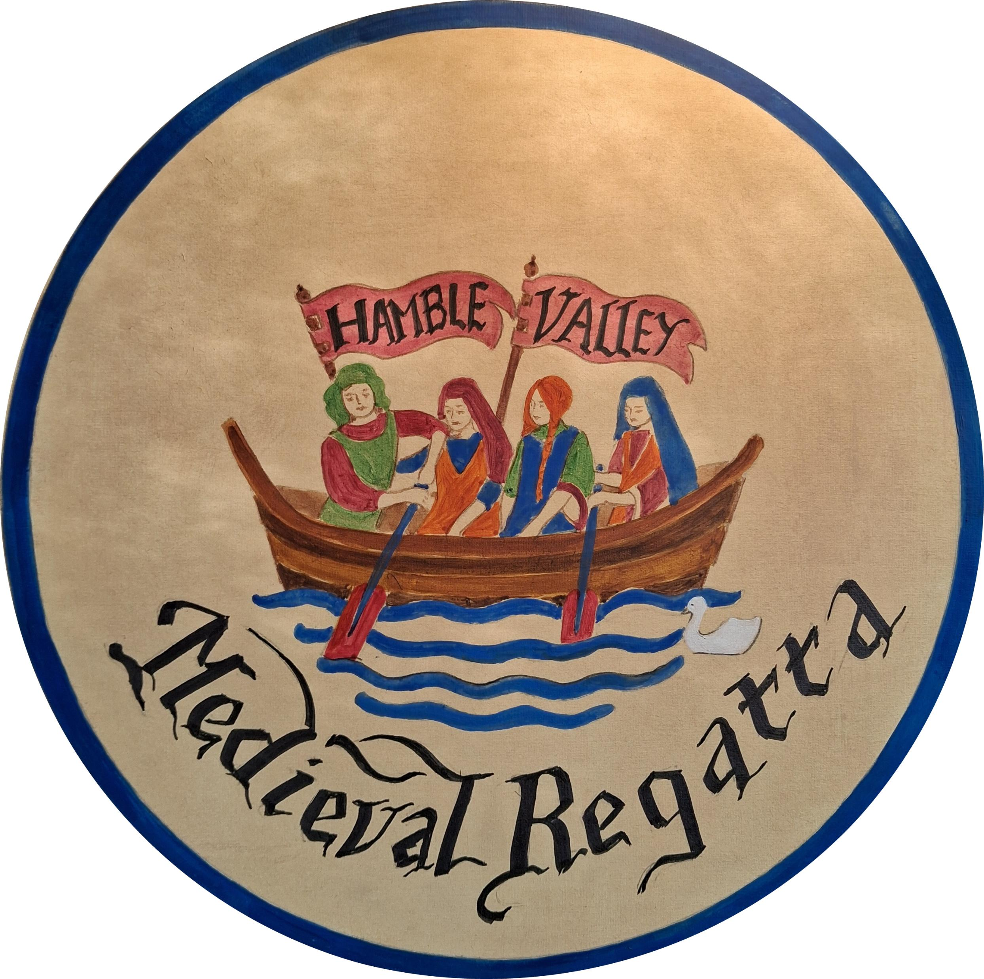
Hamble Valley Regatta
2026

Slide 2
About the Regatta
This traditional regatta is more than 150 years old and over time has been hosted by Bursledon, Swanwick and Warsash.
The Regatta moved to Hamble in 2024, complete with the new Hamble Valley Regatta name.
The Regatta is a fun annual event for families in Hamble and all the villages around the river.
This year the theme is Medieval, to celebrate the River Hamble’s incredible history.

Slide 3
Regatta Events
A regatta is all about being on and around the water.
The Hamble Valley Regatta has lots of events:
Dinghy racing
Yacht racing
Gig racing
Rowing racing
Fun events like dinghy paddling with your hands

Slide 4
Taking Part
You can enter the yacht, dinghy and gig racing from the website:
For the fun events just turn up on the foreshore at about midday on Sunday 30th August. If you want to row or paddleboard you will need to bring your own boat or bard.
Bring a life jacket if you want to row or paddleboard or be on the water.
If you have your own dinghy, you can take part in the carnival!

Slide 5
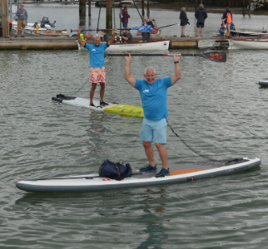
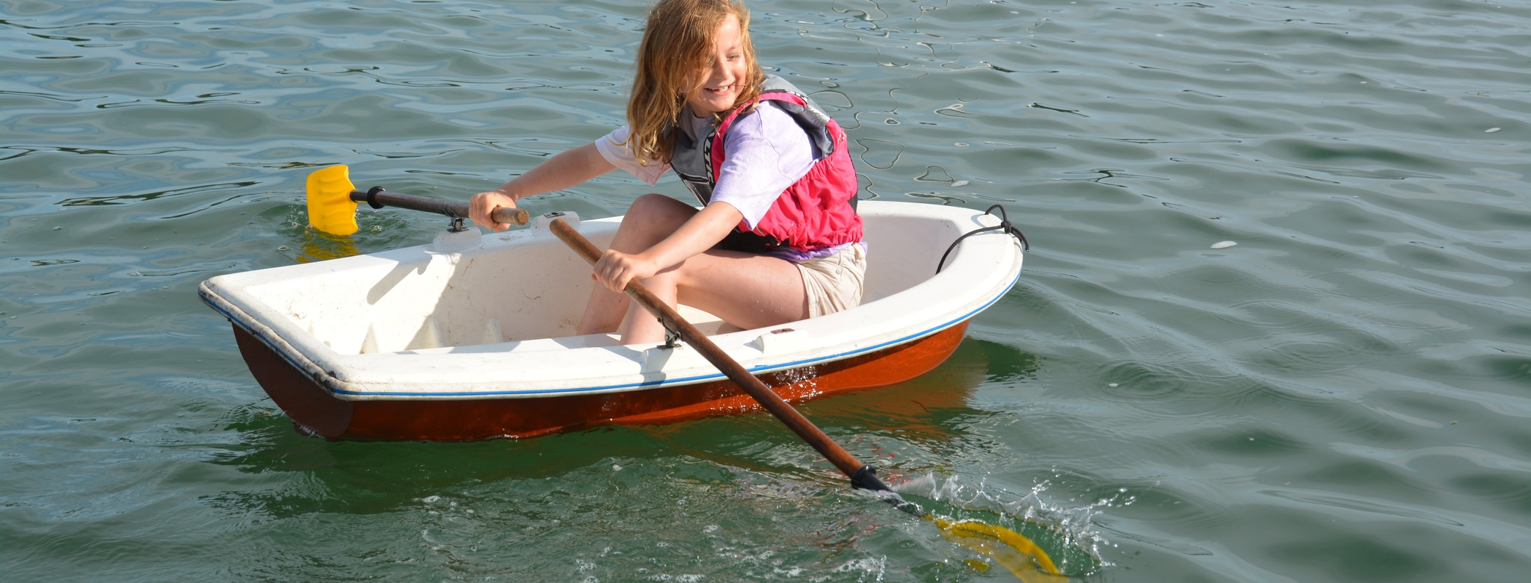
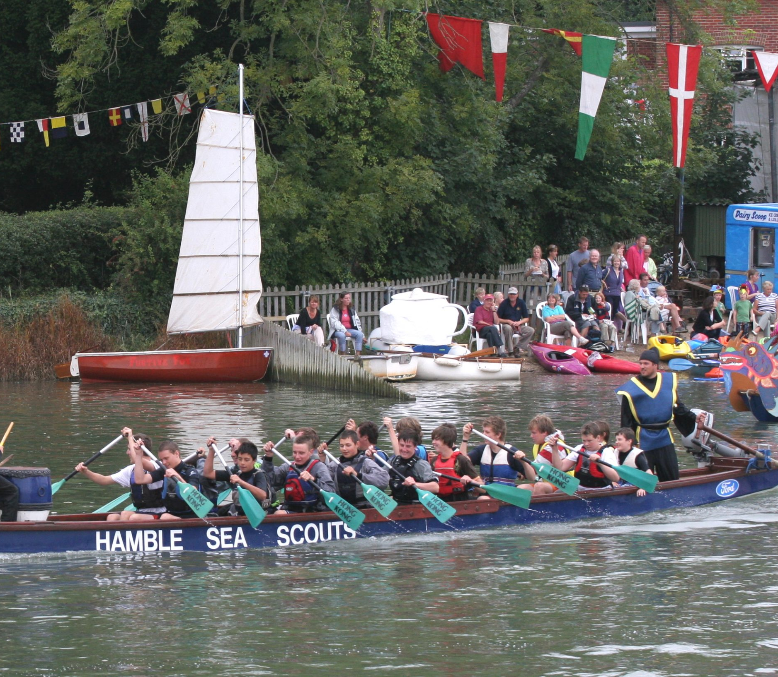
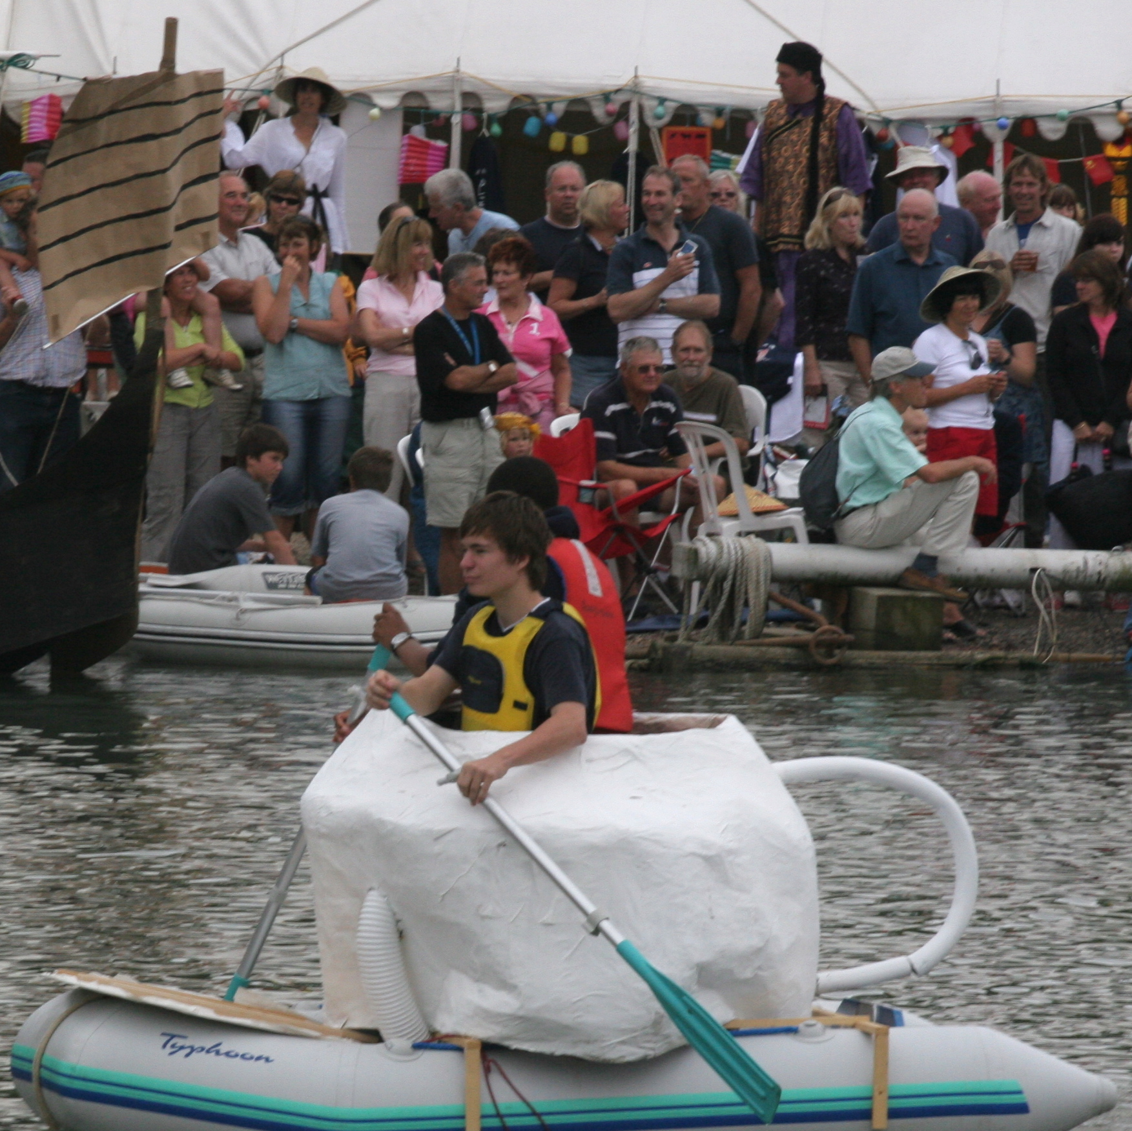
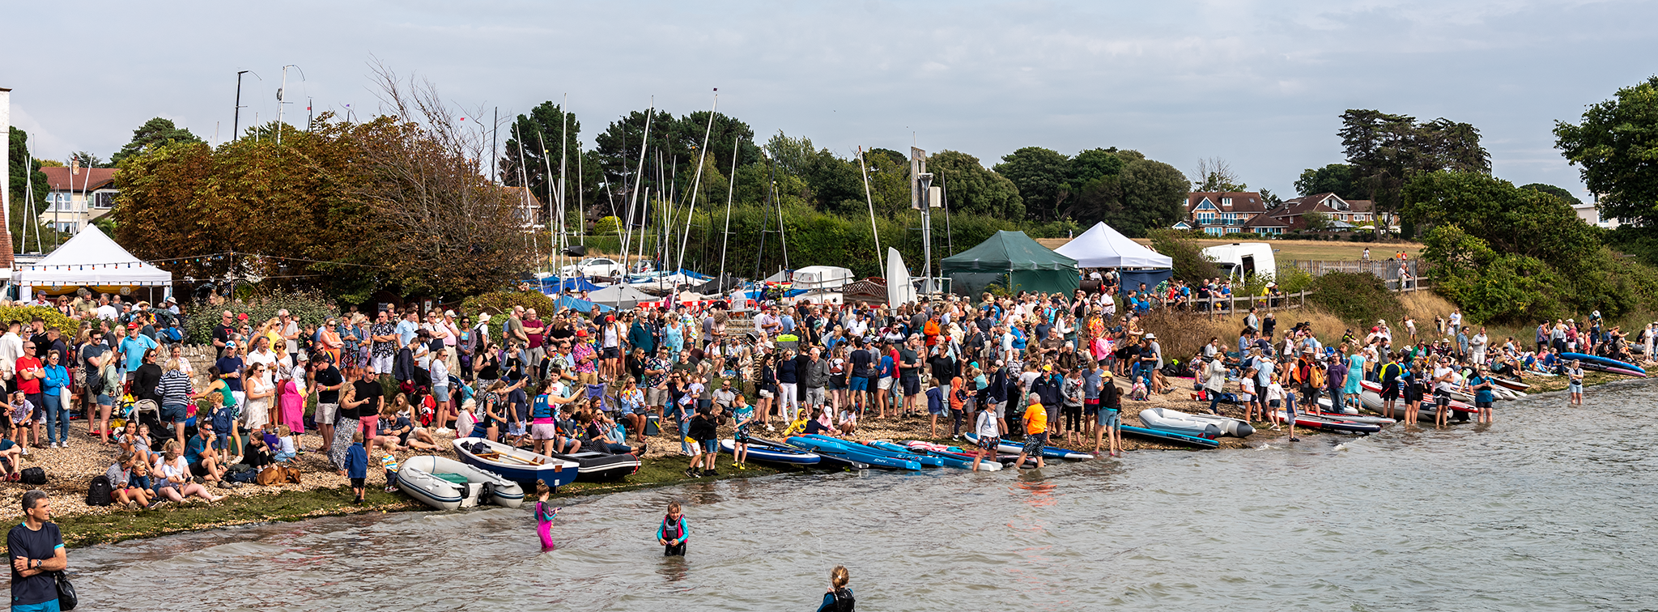

Slide 6
Regatta 2026 - Medieval
The theme this year is medieval to celebrate Hamble’s medieval history.
The medieval period is from 500 to 1500 CE
In this time the village church was built
The priory was built and destroyed
Many ships were built on the river
The village sent many sailors to battle for England on warships

Slide 7
Regatta 2026 - Medieval
The Village was attacked by Vikings, and later by the French
Villagers still went on with their daily lives:
Growing crops and raising animals
Fishing, trading, going to market, using the ferry
Shipbuilding and sailing both locally and off to foreign lands

Slide 8
Hambleux Tapestry
The regatta would like to celebrate the River Hamble’s medieval heritage
And the return of the Bayeux Tapestry to England in July 2026
Please design and colour a panel in the style of the Bayeux tapestry showing some feature of Medieval life on the river
You can download a template from the website
There are also some panels that you can simply colour in

Slide 9
Hambleux Tapestry
You could draw
Fishermen
Monks at the priory
Shipbuilding
Hamble ferry
Children playing or anything else you can think of!

Slide 10
